Slide 1
Multithreading in Java

Slide 2
What is multithreading?
Multithreading in java is a process of executing multiple threads simultaneously.
Thread is basically a lightweight sub-process, a smallest unit of processing. Multiprocessing and multithreading, both are used to achieve multitasking.
But we use multithreading than multiprocessing because threads share a common memory area. They don't allocate separate memory area so saves memory, and context-switching between the threads takes less time than process.
Java Multithreading is mostly used in games, animation etc

Slide 3

Funny example

Slide 4
Advantage of Java Multithreading
1) It doesn't block the user because threads are independent and you can perform multiple operations at same time.
2) You can perform many operations together so it saves time.
3) Threads are independent so it doesn't affect other threads if exception occur in a single thread.

Slide 5
Multitasking
Multitasking is a process of executing multiple tasks simultaneously. We use multitasking to utilize the CPU. Multitasking can be achieved by two ways:
Process-based Multitasking(Multiprocessing)
Thread-based Multitasking(Multithreading)

Slide 6
1) Process-based Multitasking (Multiprocessing)
Each process have its own address in memory i.e. each process allocates separate memory area.
Process is heavyweight.
Cost of communication between the process is high.
Switching from one process to another require some time for saving and loading registers, memory maps, updating lists etc.

Slide 7
2) Thread-based Multitasking (Multithreading)
Threads share the same address space.
Thread is lightweight.
Cost of communication between the thread is low.
Note: At least one process is required for each thread.

Slide 8
What is Thread in java
A thread is a lightweight sub process, a smallest unit of processing. It is a separate path of execution.
Threads are independent, if there occurs exception in one thread, it doesn't affect other threads. It shares a common memory area.

Slide 9
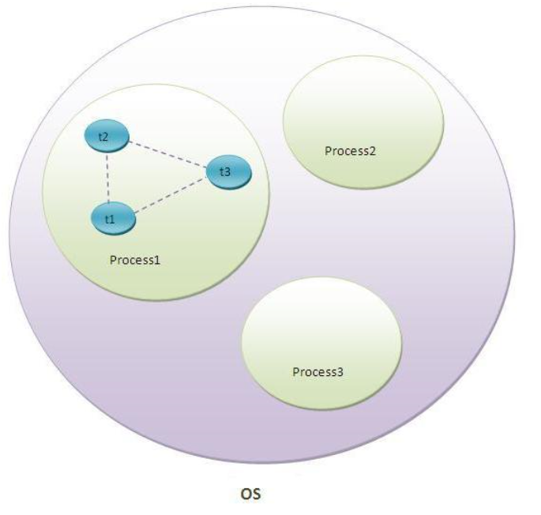
As shown in the above figure, thread is executed inside the process. There is context-switching between the threads. There can be multiple processes inside the OS and one process can have multiple threads.

Slide 10
Life cycle of a Thread (Thread States)
A thread can be in one of the five states. According to sun, there is only 4 states in thread life cycle in java new, runnable, non-runnable and terminated. There is no running state.
But for better understanding the threads, we are explaining it in the 5 states.
The life cycle of the thread in java is controlled by JVM. The java thread states are as follows:
New
Runnable
Running
Non-Runnable (Blocked)
Terminated

Slide 11
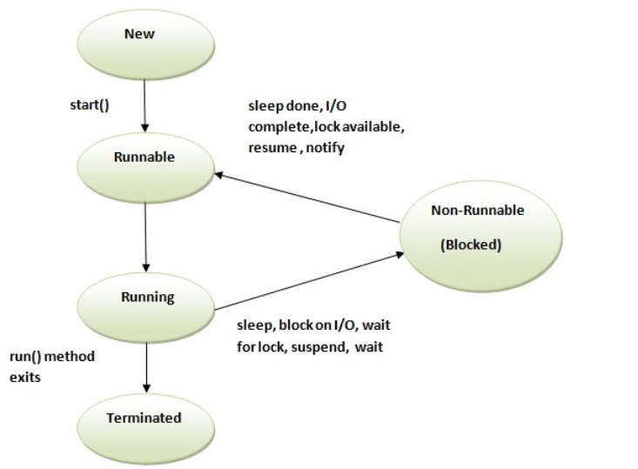

Slide 12
1) New
The thread is in new state if you create an instance of Thread class but before the invocation of start() method.
2) Runnable
The thread is in runnable state after invocation of start() method, but the thread scheduler has not selected it to be the running thread.
3) Running
The thread is in running state if the thread scheduler has selected it.
4) Non-Runnable (Blocked)
This is the state when the thread is still alive, but is currently not eligible to run.
5) Terminated
A thread is in terminated or dead state when its run() method exits.

Slide 13
How to create thread
There are two ways to create a thread:
1. By extending Thread class
2. By implementing Runnable interface.

Slide 14
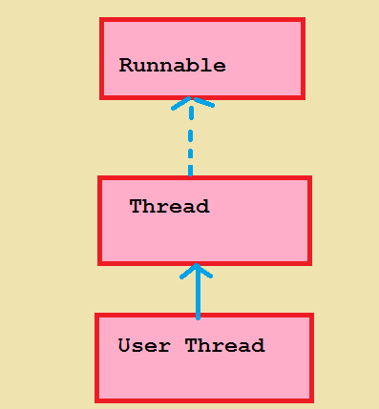
1. By Extending Thread Class

Slide 15
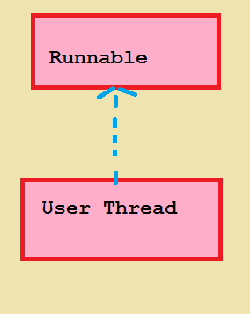
2. By Implementing Runnable Interface

Slide 16
Thread class:
Thread class provide constructors and methods to create and perform operations on a thread. Thread class extends Object class and implements Runnable interface.

Slide 17
Commonly used Constructors of Thread class:
Thread()
Thread(String name)
Thread(Runnable r)
Thread(Runnable r,String name)

Slide 18
Commonly used methods of Thread class
public void run(): is used to perform action for a thread.
public void start(): starts the execution of the thread.JVM calls the run() method on the thread.
public void sleep(long miliseconds): Causes the currently executing thread to sleep (temporarily cease execution) for the specified number of milliseconds.
public void join(): which allows one thread to wait until another thread completes its execution..
public void join(long miliseconds): waits for a thread to die for the specified miliseconds.
public int getPriority(): returns the priority of the thread.
public int setPriority(int priority): changes the priority of the thread.
public String getName(): returns the name of the thread.
public void setName(String name): changes the name of the thread.
public Thread currentThread(): returns the reference of currently executing thread.

Slide 19
Commonly used methods of Thread class (contd..)
public int getId(): returns the id of the thread.
public Thread.State getState(): returns the state of the thread.
public boolean isAlive(): tests if the thread is alive.
public void yield(): causes the currently executing thread object to temporarily pause and allow other threads to execute.
public void suspend(): is used to suspend the thread(depricated).
public void resume(): is used to resume the suspended thread(depricated).
public void stop(): is used to stop the thread(depricated).
public boolean isDaemon(): tests if the thread is a daemon thread.
public void setDaemon(boolean b): marks the thread as daemon or user thread.
public void interrupt(): interrupts the thread.
public boolean isInterrupted(): tests if the thread has been interrupted.
public static boolean interrupted(): tests if the current thread has been interrupted.

Slide 20
Runnable interface
The Runnable interface should be implemented by any class whose instances are intended to be executed by a thread. Runnable interface have only one method named run().
public void run(): is used to perform action for a thread.

Slide 21
Starting a thread
start() method of Thread class is used to start a newly created thread. It performs following tasks: A new thread starts(with new callstack).
The thread moves from New state to the Runnable state.
When the thread gets a chance to execute, its target run() method will run.

Slide 22
1)By extending Thread class:
public class MyUserDefinedThread extends Thread{
@Override
public void run() { //running state
System.out.println("My userdefined thread is running");
} //terminated state
public static void main(String[] args) {
MyUserDefinedThread m = new MyUserDefinedThread(); //new state
m.start(); //runnable state
}
}

Slide 23


Slide 24
Who makes your class object as thread object?
Thread class constructor allocates a new thread object.When you create object of Multi class,your class constructor is invoked(provided by Compiler) fromwhere Thread class constructor is invoked(by super() as first statement).So your Multi class object is thread object now.

Slide 25
2)By implementing the Runnable interface:
public class MyUserThread implements Runnable {
public static void main(String[] args) {
MyUserThread m = new MyUserThread();
Thread t = new Thread(m); //user defined thread doesn't have start method
t.start();
}
@Override
public void run() {
System.out.println("MyUserThread is running");
}}

Slide 26
Multithreading Example – Multiple threads simultaneous execution
public class MultiThread extends Thread{
public void run() {
for (int i = 1; i < 6; i++) {
System.out.println(i);
}}
public static void main(String[] args) throws InterruptedException { //main thread
MultiThread t1 = new MultiThread();
MultiThread t2 = new MultiThread();
t1.start();
t2.start();
}}

Slide 27
Output Note: Here output is not same always in Multithreading It depends on Thread scheduling
1
1
2
3
4
5
2
3
4
5

Slide 28
Notes:
If you are not extending the Thread class, your class object would not be treated as a thread object.
So you need to explicitly create Thread class object.We are passing the object of your class that implements Runnable so that your class run() method may execute.

Slide 29
What will happen if we don’t override Thread class run() method?
No Exception is thrown.
Super class run() is invoked.

Slide 30
Sleep method in java
The sleep() method of Thread class is used to sleep a thread for the specified amount of time.
Syntax of sleep() method in java
The Thread class provides two methods for sleeping a thread:
public static void sleep(long miliseconds)throws InterruptedException
public static void sleep(long miliseconds, int nanos)throws InterruptedException

Slide 31
Example of sleep method in java
public class TestSleepMethod extends Thread{
@Override
public void run() {
for (int i = 1; i < 6; i++) {
try {
Thread.sleep(1000);
} catch (InterruptedException e) {
e.printStackTrace();
}
System.out.println(i);
}}
public static void main(String[] args) throws InterruptedException { //main thread
TestSleepMethod t1 = new TestSleepMethod();
TestSleepMethod t2 = new TestSleepMethod();
t1.start();
t2.start();
}}

Slide 32
Difference between sleep and yield methods?
when a thread invokes its yield method, it returns to the ready state.
when a task invokes its sleep method, it returns to the waiting state.
Summary:
Yield – ready state
Sleep – waiting state

Slide 33
Why Thread sleep() and yield() methods are static?
Thread sleep() and yield() methods work on the currently executing thread. So there is no point in invoking these methods on some other threads that are in wait state.
That’s why these methods are made static so that when this method is called statically, it works on the current executing thread and avoid confusion to the programmers who might think that they can invoke these methods on some non-running threads.

Slide 34
Can we start a thread twice??
No. After starting a thread, it can never be started again.
If you does so, an IllegalThreadStateException is thrown. In such case, thread will run once but for second time, it will throw exception.

Slide 35
public class TestThreadTwice extends Thread{
public void run(){
System.out.println("running...");
}
public static void main(String args[]){
TestThreadTwice t1=new TestThreadTwice();
t1.start();
t1.start();
}
}
Output:
running
Exception in thread "main" java.lang.IllegalThreadStateException

Slide 36
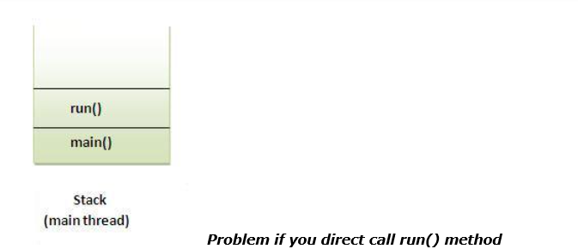
What if we call run() method directly instead start() method?
Each thread starts in a separate call stack.
Invoking the run() method from main thread, the run() method goes onto the current call stack rather than at the beginning of a new call stack
Output:running...

Slide 37
Problem if you directly call run() method
class TestCallRun extends Thread{
public void run(){
for(int i=1;i<5;i++){
try{Thread.sleep(500);}catch(InterruptedException e){System.out.println(e);}
System.out.println(i);
}
}
public static void main(String args[]){
TestCallRun t1=new TestCallRun();
TestCallRun t2=new TestCallRun();
t1.run();
t2.run();
}
}

Slide 38
Output
1
2
3
4
5
1
2
3
4
5
Observation: As you can see in the above program that there is no context-switching because here t1 and t2 will be treated as normal object not thread object.

Slide 39
Note point***
Thread scheduling is controlled by thread scheduler. So, You cannot guarantee the order of execution of threads under normal circumstances.
However if you use join(), it makes sure that as soon as a thread calls join, then current thread will not execute unless the thread you have called join is finished.

Slide 40
The join() method:
The join() method which allows one thread to wait until another thread completes its execution.
In other words, it causes the currently running threads to stop executing until the thread you have called joins with completes its task.
Syntax
public void join()throws InterruptedException
public void join(long milliseconds)throws InterruptedException

Slide 41
Example of join() method
public class TestSleepMethod extends Thread{
public void run() {
for (int i = 1; i < 6; i++) {
try {
Thread.sleep(1000);
} catch (InterruptedException e) {
e.printStackTrace();
}
System.out.println(i);
}}
public static void main(String[] args) throws InterruptedException { //main thread
TestSleepMethod t1 = new TestSleepMethod();
TestSleepMethod t2 = new TestSleepMethod();
TestSleepMethod t3 = new TestSleepMethod();
t1.start();
t1.join(); //it seems t2 and t3 are waiting for t1 completion
//actually main thread waits for t1 completion
t2.start();
t3.start();
}}

Slide 42
output
1
2
3
4
5
1
1
2
2
3
3
4
4
5
5

Slide 43
Note
Remember: Main thread is executing main method
It seems t1 affects t2 and t3 to wait But actually affecting main thread.
Here Main thread waits for t1 completion

Slide 44
Example of join(long miliseconds) method
public class TestSleepMethod extends Thread{
public void run() {
for (int i = 1; i < 6; i++) {
try {
Thread.sleep(1000);
} catch (InterruptedException e) {
e.printStackTrace();
}
System.out.println(i);
}}
public static void main(String[] args) throws InterruptedException { //main thread
TestSleepMethod t1 = new TestSleepMethod();
TestSleepMethod t2 = new TestSleepMethod();
TestSleepMethod t3 = new TestSleepMethod();
t1.start();
t1.join(1500); //actually main thread waits for t1 completion up to 1500 milliseconds
t2.start();
t3.start();
}}

Slide 45
Naming a Thread
getName(),setName(String) and getId() method
public String getName()
public void setName(String name)
public long getId()
The Thread class provides methods to change and get the name of a thread.
public String getName(): is used to return the name of a thread.
public void setName(String name): is used to change the name of a thread.

Slide 46
How can we make sure main() is the last thread to finish in Java Program?
We can use Thread join() method to make sure all the threads created by the program is dead before finishing the main function.
main(){
try {
t1.join();
t2.join();
t3.join();
} catch (InterruptedException e) {
// TODO Auto-generated catch block
e.printStackTrace();
}
}

Slide 47
class TestJoinMethod3 extends Thread{
public void run(){
System.out.println("running...");
}
public static void main(String args[]){
TestJoinMethod3 t1=new TestJoinMethod3();
TestJoinMethod3 t2=new TestJoinMethod3();
System.out.println("Name of t1:"+t1.getName());
System.out.println("Name of t2:"+t2.getName());
System.out.println("id of t1:"+t1.getId());
t1.start();
t2.start();
t1.setName("Sonoo Jaiswal");
System.out.println("After changing name of t1:"+t1.getName());
}
}

Slide 48
output
Output:Name of t1:Thread-0
Name of t2:Thread-1
id of t1:8
running...
After changling name of t1:Sonoo Jaiswal
running...

Slide 49
The currentThread() method:
The currentThread() method returns a reference to the currently executing thread object.
Syntax
public static Thread currentThread()

Slide 50
Example of currentThread() method
class TestJoinMethod4 extends Thread{
public void run(){
System.out.println(Thread.currentThread().getName());
}
}
public static void main(String args[]){
TestJoinMethod4 t1=new TestJoinMethod4();
TestJoinMethod4 t2=new TestJoinMethod4();
t1.start();
t2.start();
}
}

Slide 51
Output
Thread-0
Thread-1

Slide 52
Priority of a Thread (Thread Priority):
Each thread have a priority. Priorities are represented by a number between 1 and 10. In most cases, thread schedular schedules the threads according to their priority (known as preemptive scheduling). But it is not guaranteed because it depends on JVM specification that which scheduling it chooses.

Slide 53
3 constants defined in Thread class:
public static int MIN_PRIORITY
public static int NORM_PRIORITY
public static int MAX_PRIORITY
Default priority of a thread is 5 (NORM_PRIORITY). The value of MIN_PRIORITY is 1 and the value of MAX_PRIORITY is 10

Slide 54
class TestMultiPriority extends Thread{
public void run(){
System.out.println("running thread name is:"+Thread.currentThread().getName());
System.out.println("running thread priority is:"+Thread.currentThread().getPriority());
}
public static void main(String args[]){
TestMultiPriority m1=new TestMultiPriority1();
TestMultiPriority m2=new TestMultiPriority1();
m1.setPriority(Thread.MIN_PRIORITY);
m2.setPriority(Thread.MAX_PRIORITY);
m1.start();
m2.start();
}
}

Slide 55
What is Daemon thread
Daemon thread runs in background and mostly created by JVM for performing background task like Garbage collection and other house keeping tasks
Daemon threads executes on low priority.
Daemon threads acts as services in Windows.
Daemon threads are typically used to perform services for your application.

Slide 56
Important points about Daemon threads in Java
Thread.setDaemon(true) makes a Thread daemon but it can only be called before starting Thread in Java.
It will throw IllegalThreadStateException if corresponding Thread is already started and running.
isDaemon() is used to check that current is daemon.

Slide 57
Java Synchronization

Slide 58
Synchronization in Java
Synchronization in java is the capability to control the access of multiple threads to any shared resource.
Java Synchronization is better option where we want to allow only one thread to access the shared resource.

Slide 59
Why use Synchronization
To prevent thread interference.
To prevent consistency problem.

Slide 60
Synchronization can be achieved in two ways
Synchronized method.
Synchronized block.

Slide 61
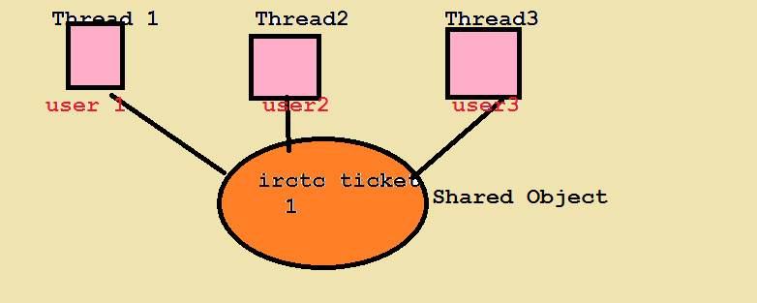
Understanding Problem without Synchronization

Slide 62
Understanding the problem without Synchronization
In this example, there is no synchronization, so output is inconsistent. Let's see the example:

Slide 63
class Table{
void printTable(int num){
System.out.println("print table is started");
for(int i=1; i<=10; i++){
System.out.println(i+" * "+num+" = "+(i*num));
}
System.out.println("print table is ended");
}
}
class Thread1 extends Thread{
Table table;
Thread1(Table t){
table = t;
}
@Override
public void run() {
table.printTable(10);
}
}

Slide 64
class Thread2 extends Thread{
Table table;
Thread2(Table t){
table = t;
}
@Override
public void run() {
table.printTable(100);
}}
public class SynchronizationTest {
public static void main(String[] args) {
Table table = new Table();
Thread1 t1 = new Thread1(table);
Thread2 t2 = new Thread2(table);
t1.start();
t2.start();
}}

Slide 65
Output
1 * 10 = 10
1 * 100 = 100
2 * 100 = 200
2 * 10 = 20
3 * 10 = 30
3 * 100 = 300
4 * 10 = 40
4 * 100 = 400
5 * 100 = 500
5 * 10 = 50
6 * 100 = 600
6 * 10 = 60
7 * 100 = 700
7 * 10 = 70
8 * 100 = 800
8 * 10 = 80
9 * 100 = 900
9 * 10 = 90
10 * 100 = 1000
10 * 10 = 100

Slide 66
Java synchronized method
If you declare any method as synchronized, it is known as synchronized method.
Synchronized method is used to lock an object for any shared resource.
When a thread invokes a synchronized method, it automatically acquires the lock for that object and releases it when the thread completes its task.

Slide 67
Example of synchronized method

Slide 68
class Table{
synchronized void printTable(int num){
System.out.println("print table is started");
for(int i=1; i<=10; i++){
System.out.println(i+" * "+num+" = "+(i*num));
}
System.out.println("print table is ended");
}
}
class Thread1 extends Thread{
Table table;
Thread1(Table t){
table = t;
}
@Override
public void run() {
table.printTable(10);
}
}

Slide 69
class Thread2 extends Thread{
Table table;
Thread2(Table t){
table = t;
}
@Override
public void run() {
table.printTable(100);
}}
public class SynchronizationTest {
public static void main(String[] args) {
Table table = new Table();
Thread1 t1 = new Thread1(table);
Thread2 t2 = new Thread2(table);
t1.start();
t2.start();
}}

Slide 70
output
1 * 100 = 100
2 * 100 = 200
3 * 100 = 300
4 * 100 = 400
5 * 100 = 500
6 * 100 = 600
7 * 100 = 700
8 * 100 = 800
9 * 100 = 900
10 * 100 = 1000
1 * 10 = 10
2 * 10 = 20
3 * 10 = 30
4 * 10 = 40
5 * 10 = 50
6 * 10 = 60
7 * 10 = 70
8 * 10 = 80
9 * 10 = 90
10 * 10 = 100

Slide 71
Synchronized block in java
Synchronized block can be used to perform synchronization on any specific resource of the method.
Suppose you have 50 lines of code in your method, but you want to synchronize only 5 lines, you can use synchronized block.
If you put all the codes of the method in the synchronized block, it will work same as the synchronized method.

Slide 72
Points to remember for Synchronized block
Synchronized block is used to lock an object for any shared resource.
Scope of synchronized block is smaller than the method.

Slide 73
Syntax to use synchronized block
synchronized (object reference expression) {
//code block
}

Slide 74
Example of synchronized block

Slide 75
class Table{
void printTable(int num){
System.out.println("print table is started");
synchronized(this){
for(int i=1; i<=10; i++){
System.out.println(i+" * "+num+" = "+(i*num));
}
}
System.out.println("print table is ended");
}
}
class Thread1 extends Thread{
Table table;
Thread1(Table t){
table = t;
}
@Override
public void run() {
table.printTable(10);
}
}

Slide 76
class Thread2 extends Thread{
Table table;
Thread2(Table t){
table = t;
}
@Override
public void run() {
table.printTable(100);
}
}
public class SynchronizationTest {
public static void main(String[] args) {
Table table = new Table();
Thread1 t1 = new Thread1(table);
Thread2 t2 = new Thread2(table);
t1.start();
t2.start();
}
}

Slide 77
output
1 * 100 = 100
2 * 100 = 200
3 * 100 = 300
4 * 100 = 400
5 * 100 = 500
6 * 100 = 600
7 * 100 = 700
8 * 100 = 800
9 * 100 = 900
10 * 100 = 1000
1 * 10 = 10
2 * 10 = 20
3 * 10 = 30
4 * 10 = 40
5 * 10 = 50
6 * 10 = 60
7 * 10 = 70
8 * 10 = 80
9 * 10 = 90
10 * 10 = 100

Slide 78
Deadlocks in java

Slide 79
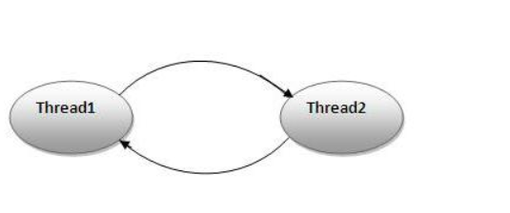
What is Deadlock and How to analyze and avoid deadlock situation?
Deadlock is a programming situation where two or more threads are blocked forever, this situation arises with at least two threads and two or more resources.
To analyze a deadlock, we need to look at the java thread dump of the application, we need to look out for the threads with state as BLOCKED and then the resources it’s waiting to lock, Every resource has a unique ID using which we can find which thread is already holding the lock on the object.
Ex:
Deadlock can occur in a situation when a thread is waiting for an object lock, that is acquired by another thread and second thread is waiting for an object lock that is acquired by first thread.
Since, both threads are waiting for each other to release the lock, the condition is called deadlock.

Slide 80
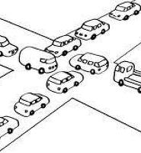
Best example

Slide 81

Funny example

Slide 82

Another deadlock example

Slide 83
public class DeadLockExample {
public static void main(String[] args) {
String resource1 = "SAI";
Integer resource2 = 100;
Thread t1 =new Thread(){
public void run() {
synchronized (resource1) {
System.out.println("resource1 is locked by t1");
try {
Thread.sleep(1000);
} catch (InterruptedException e) {
e.printStackTrace();
}
System.out.println("t1 is waiting for lock on resource 2");
synchronized (resource2) {
System.out.println("resource 2 ");
}
}
System.out.println("run method execution is completed by t1");
}
};
t1.start();

Slide 84
Thread t2 =new Thread(){
public void run() {
synchronized (resource2) {
System.out.println("resource2 is locked by t2");
try {
Thread.sleep(1000);
} catch (InterruptedException e) {
e.printStackTrace();
}
System.out.println("t2 is waiting for lock on resource 1");
synchronized (resource1) {
System.out.println("resource 1");
}
}
System.out.println("run method execution is completed by t2");
}
};
t2.start();

Slide 85
Deadlock:
public void method1() {
synchronized (String.class) {
System.out.println("Aquired lock on String.class object");
synchronized (Integer.class) {
System.out.println("Aquired lock on Integer.class object");
}
}
}
public void method2() {
synchronized (Integer.class) {
System.out.println("Aquired lock on Integer.class object");
synchronized (String.class) {
System.out.println("Aquired lock on String.class object");
}
}
}
Without Deadlock
public void method1() {
synchronized (String.class) {
System.out.println("Aquired lock on String.class object");
synchronized (Integer.class) {
System.out.println("Aquired lock on Integer.class object");
}
}
}
public void method2() {
synchronized (String.class) {
System.out.println("Aquired lock on String.class object");
synchronized (Integer.class) {
System.out.println("Aquired lock on Integer.class object");
}
}
}

Slide 86
How to ensure N threads can access all N resources?
The order N threads acquire the locks on resources, release the locks in reverse order

Slide 87
How to avoid deadlocks
if you have looked above code carefully you may have figured out that real reason for deadlock is not multiple threads but the way they access lock
1. Always acquire the locks in the same order
2. write a proper logic using wait() and notify() methods

